Slide 1
Cardiovascular Disease Detection
Using python and machine learning

Slide 2
Introduction
To develop a web application that can accurately predict the likelihood of a person having any cardiovascular disease
Aims to leverage machine learning techniques to build the predictive model that can analyze the input and provide outcome
Heart disease has been the leading cause of death and early identification can lead to timely medical intervention and improved outcome in patients.
The collected and preprocessed data will be used to train the machine learning model, Random Forest algorithm will be used for decision making
The model’s performance will be evaluated using appropriate metrices, like accuracy.
Involves creating a user friendly web-based interface to get few input parameters from users which then will be passed through trained machine learning model for prediction.
Uses Flask as a web framework

Slide 3
Application Architecture
Frontend
HTML: The user interface is built using HTML which provides structure and elements for interaction.
CSS: is used to define the presentation and styling of HTML file
Javascript: used for client-side interactivity such as displaying the prediction result.
Backend
Flask: Flask, a python web framework, handles the backend logic and the communication between front end and server.
Python: The core logic of program is implemented using python, allowing data processing, machine learning and web server functionalities.
Data preprocessing
Pandas: used in reading, manipulating, preprocessing the dataset stored in CSV file.
Data Cleaning: preprocessing steps are performed to handle missing values.
Feature Scaling: StandardScaler from scikit-learn is employed to scale the features for better model performance.

Slide 4
Machine Learning
RandomForestClassifier: The application utilizes Forest Classifier algorithm from scikit-learn for making decision trees.
Training: The classifier is trained on the preprocessed dataset to learn patterns and correlation between the input features and presence of disease.
Model Evaluation: The trained data set is evaluated using a test data set to access the accuracy.
Flask Web Application
Route: defines route to handle URL and HTTP requests, two key routes are implemented :’/’ for home page and ‘/predict’ for form submission.
Templates: Flasks uses templates to dynamically render and display content to the user.
User Input:The user enters the medical parameter through HTML forms and submitted to the ‘/predict’ for processing.
Prediction: The application uses trained model to predict the likelihood of presence of heart disease.
Result display: The prediction result is rendered in the result.html template and shown to the user.

Slide 5
Present the HTML form

Slide 6
Flask Application
Flask is used to handle form submission by defining routes that receive data from the client-side, process and responds accordingly.
When the user submits the form, the data is send to the server, and Flask’s route function can access the data using the ‘request’ object.
Import flask and request module:
Create Flask application:
Define a route for form page:
Create a route for form handling:
Run the flask application:

Slide 7
Data Preprocessing
Is a critical step in preparing input datas, involves cleaning, transforming and standardizing the data to ensure if it is suitable for learning algorithm.
Data Cleaning: Check for the missing data in the dataset and decide how to deal with them including removing the rows with missing value or others.
Data Transformation: If the data set contains any categorical values that needs to be converted into numeric value for machine learning model.
Feature Scaling:Feature Scaling is used to ensure that all the features have the similar scale. The StandardScaler is a common method to scale the features.
RandomForestClassifier
Is a supervised algorithm used for classification tasks, where the goal is to predict the class of the given input.
Is based on the concept of ensemble learning, builds multiple decision trees during training process.

Slide 8
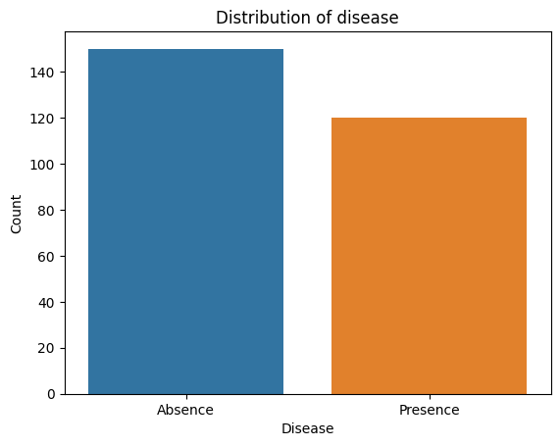

Slide 9
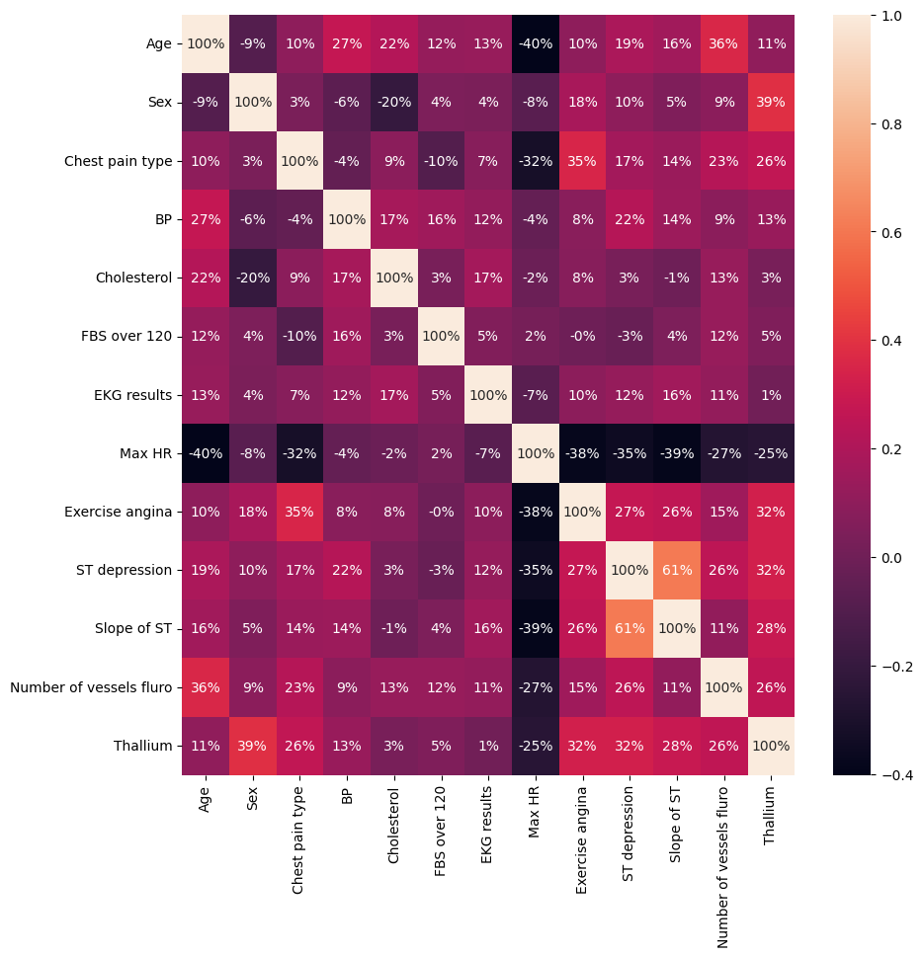

Slide 10
